Slide 2
30 Min
Cloud Compute
Upload to Azure
4 min

Slide 3
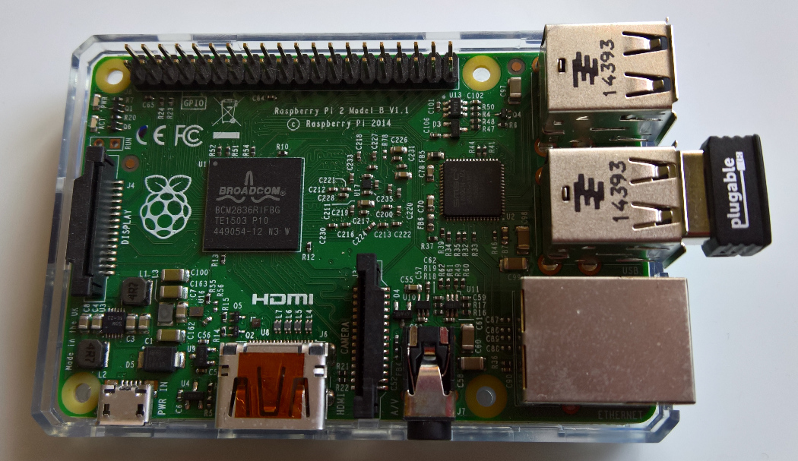
Data Movement
2
Compute Instance
1
Share
backup
3
Raspberry Pi Device
Microsoft Azure

